Slide 1
CYCLIST BIKE SHARE
CASE STUDY ANALYSIS
CREATED ON 1/24/22 by Arsha Suresh Kumar

Slide 2
Purpose of the case study
Understand how casual riders and members use bikes differently.

Slide 3
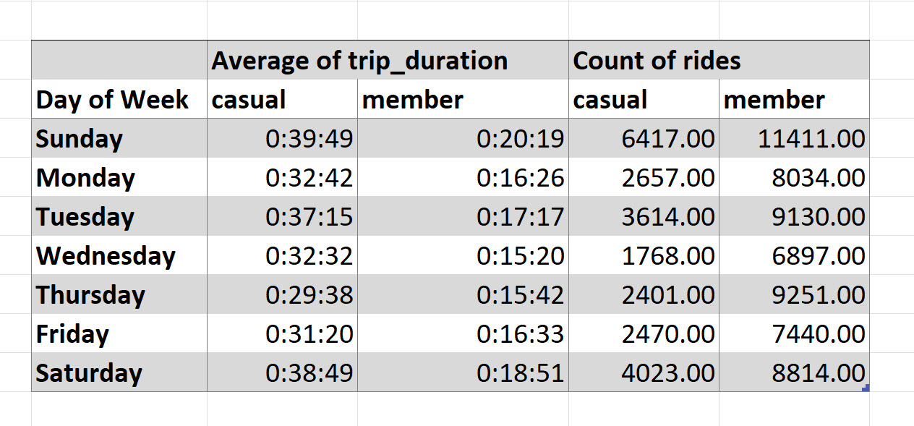
How Casual and Member riders differ- Analysis

Slide 4
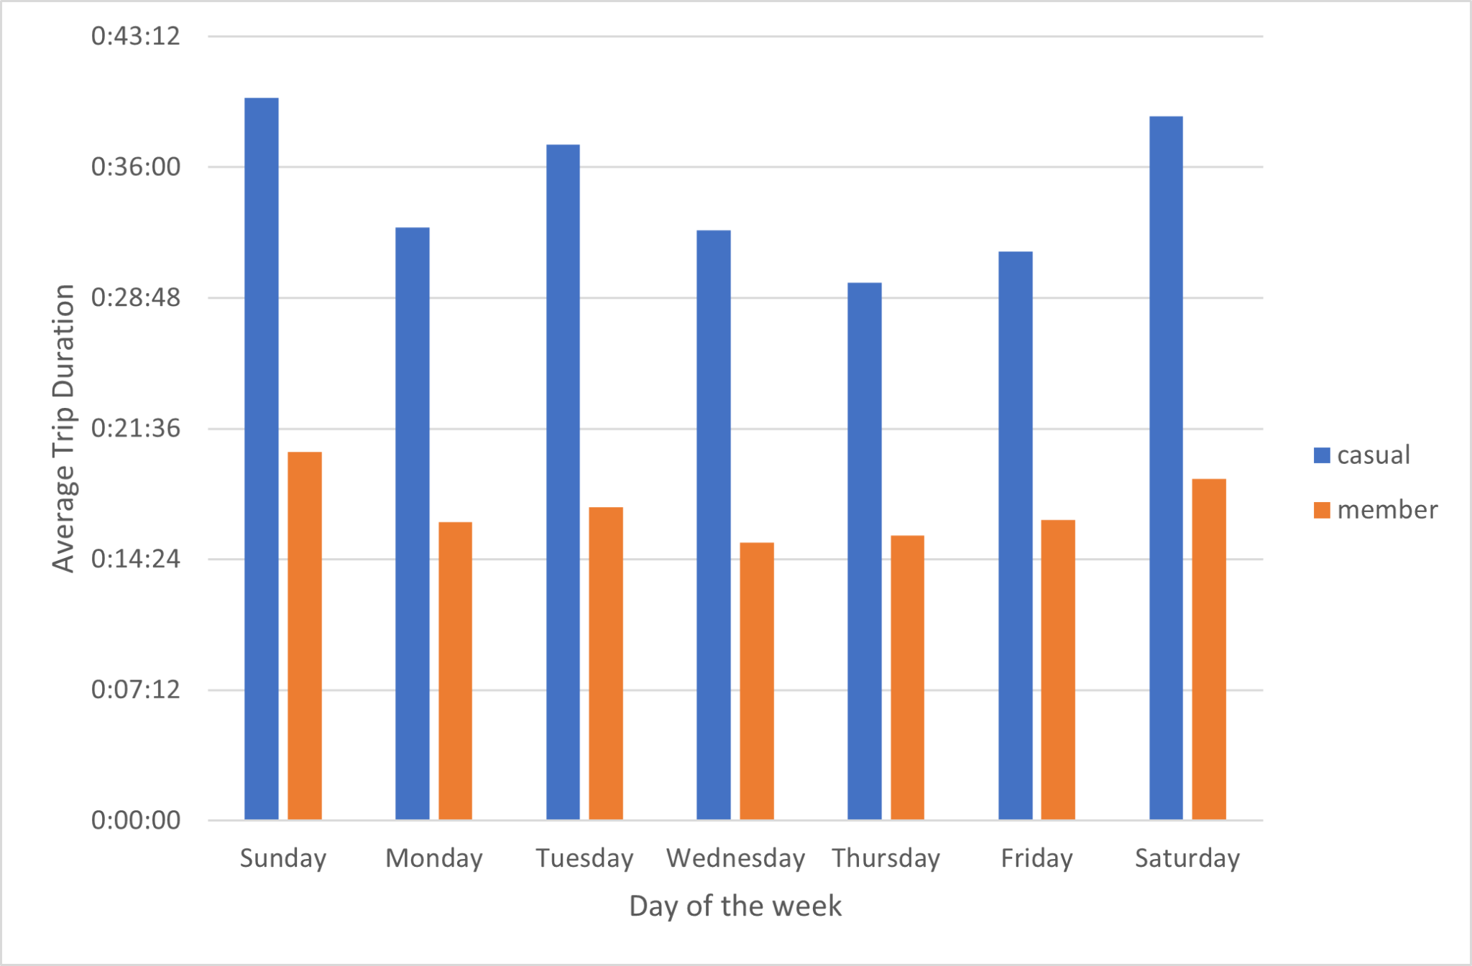
Average trip duration for each type of riders through the week

Slide 5
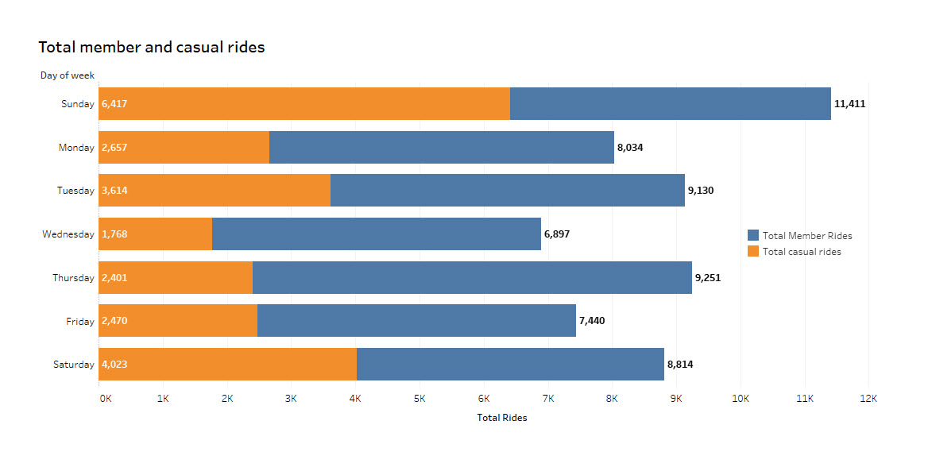
Total Member and Casual rides through the week

Slide 6
Findings
Casual members often rides more on Saturdays and Sundays.
Members rides more during weekdays possibly for commute.
Very high number of casual riders on sundays.

